Slide 1
Adaptive Catechesis Strategies, Resources and Materials to promote the inclusion and participation of people with disabilities

Slide 2
Agenda
Part 1
Introduction
Mission
Inclusion and participation
USCCB Guide Introduction
Sacraments
Part 2
Approach
Strategies
Resources and Materials
Discussion/Questions

Slide 3
Megan Wedwick, Director of the Apostolate for Persons with Disabilities – Diocese of Madison
A little about me…
Born and raised in Prairie du Chien, WI
Have my Bachelors of Science in Rehabilitation Psychology from UW Madison.
Worked in Campus Ministry, a Madison Parish, and Residential Care before starting at the APD in 2022.
My husband and I were married in January of 2022 and live in Prairie du Sac with our pup, Bjorn.
We have one baby in heaven and are expecting a little girl in October.

Slide 4
Mission of the APD
The Apostolate works to promote the full inclusion* of persons with disabilities in the life of the Church.
Every baptized person, regardless of their abilities, has received a special vocation to holiness, and we strive to promote their participation* in local parishes and diocesan events.

Slide 5
What do we mean by inclusion and participation?
To live out their Mission as baptized Catholics and Disciples of Jesus.
Inclusion: We need to stive to equip people with what they need for their God-given mission as a part of our parishes.
Participation: providing the ability to serve, not just be served.
Just as everyone’s mission looks different, so does their road to discovering what their mission is and the guidance, support, and adaptations they need to get there.

Slide 6
USCCB Document: Guidelines for Celebration of the Sacraments with Persons with Disabilities
GENERAL PRINCIPLES
1. ALL HUMAN BEINGS ARE EQUAL IN DIGNITY IN THE SIGHT OF GOD. MOREOVER, BY REASON OF THEIR BAPTISM, ALL CATHOLICS ALSO SHARE THE SAME DIVINE CALLING.
2. CATHOLICS WITH DISABILITIES HAVE A RIGHT TO PARTICIPATE IN THE SACRAMENTS AS FULLY AS OTHER MEMBERS OF THE LOCAL ECCLESIAL COMMUNITY. “SACRED MINISTERS CANNOT DENY THE SACRAMENTS TO THOSE WHO SEEK THEM AT APPROPRIATE TIMES, ARE PROPERLY DISPOSED, AND ARE NOT PROHIBITED BY LAW FROM RECEIVING THEM.”
3. PARISH SACRAMENTAL CELEBRATIONS SHOULD BE ACCESSIBLE TO PERSONS WITH DISABILITIES AND OPEN TO THEIR FULL, ACTIVE, AND CONSCIOUS PARTICIPATION, ACCORDING TO THEIR CAPACITY. PASTORAL MINISTERS SHOULD NOT PRESUME TO KNOW THE NEEDS OF PERSONS WITH DISABILITIES, BUT SHOULD RATHER—BEFORE ALL ELSE—CONSULT WITH THEM OR THEIR ADVOCATES BEFORE MAKING DETERMINATIONS ABOUT THE ACCESSIBILITY OF A PARISH’S FACILITIES AND THE AVAILABILITY OF ITS PROGRAMS, POLICIES, AND MINISTRIES. FULL ACCESSIBILITY SHOULD BE THE GOAL FOR EVERY PARISH, AND THESE ADAPTATIONS ARE TO BE AN ORDINARY PART OF THE LITURGICAL LIFE OF THE PARISH

Slide 7
4. SINCE THE PARISH IS THE CENTER OF THE CHRISTIAN EXPERIENCE FOR MOST CATHOLICS, PASTORS AND OTHER PARISH MINISTERS SHOULD MAKE EVERY EFFORT TO PROVIDE FOR ALL CATHOLICS WITH DISABILITIES WHO RESIDE WITHIN A PARISH’S BOUNDARIES. SPECIAL EFFORT SHOULD BE MADE TO REACH OUT TO AND WELCOME ALL PARISHIONERS, INCLUDING PERSONS WITH DISABILITIES WHO LIVE INDEPENDENTLY, WITH THEIR FAMILIES, IN INSTITUTIONS, OR IN OTHER LIVING ARRANGEMENTS. PASTORAL VISITATION, THE PARISH CENSUS, AND THE DIVERSE FORMS OF PARISH AND DIOCESAN SOCIAL COMMUNICATION ARE JUST A FEW OF THE MANY WAYS IN WHICH THE PASTORAL STAFF CAN WORK TOWARD THE INCLUSION OF ALL PARISHIONERS IN THE PARISH’S SACRAMENTAL LIFE.
5. PASTORS ARE RESPONSIBLE TO PROVIDE EVANGELIZATION, CATECHETICAL FORMATION, AND SACRAMENTAL PREPARATION FOR PARISHIONERS WITH DISABILITIES, AND DIOCESES ARE ENCOURAGED TO ESTABLISH APPROPRIATE SUPPORT SERVICES TO ASSIST PASTORS IN THIS DUTY. PERSONS WITH DISABILITIES, THEIR ADVOCATES AND THEIR FAMILIES, AS WELL AS THOSE KNOWLEDGEABLE IN SERVING THOSE WITH DISABILITIES CAN MAKE A MOST VALUABLE CONTRIBUTION TO THESE EFFORTS. PARISH CATECHETICAL AND SACRAMENTAL PREPARATION PROGRAMS MAY NEED TO BE ADAPTED FOR SOME PARISHIONERS WITH DISABILITIES, THOUGH, AS MUCH AS POSSIBLE, PERSONS WITH DISABILITIES SHOULD BE INTEGRATED INTO THE ORDINARY PROGRAMS. THEY SHOULD NOT BE SEGREGATED FOR SPECIALIZED CATECHESIS UNLESS THEIR DISABILITIES MAKE IT IMPOSSIBLE FOR THEM TO PARTICIPATE IN THE BASIC CATECHETICAL PROGRAM. EVEN IN THOSE CASES, PARTICIPATION IN PARISH LIFE IS ENCOURAGED IN ALL WAYS POSSIBLE.

Slide 8
6. HAVING RECEIVED THE SACRAMENTS, WHICH “CONTRIBUTE IN THE GREATEST WAY TO ESTABLISH, STRENGTHEN, AND MANIFEST ECCLESIASTICAL COMMUNION,” PERSONS WITH DISABILITIES, LIKE ALL OTHER PARISHIONERS, SHOULD BE ENCOURAGED TO PARTICIPATE IN ALL LEVELS OF PASTORAL MINISTRY THAT ARE AVAILABLE AND FOR WHICH THEY ARE QUALIFIED. FOR EXAMPLE, MEMBERS OF THE LAITY ARE OFTEN NEEDED TO PERFORM VARIOUS SERVICES OR FUNCTIONS IN LITURGICAL CELEBRATIONS, PARTICULARLY IN THE CELEBRATION OF MASS. IN CHOOSING THOSE WHO WILL BE INVITED TO USE THEIR GIFTS IN SERVICE TO THE PARISH COMMUNITY, THE PARISH PASTORAL STAFF AND LAY VOLUNTEERS, INCLUDING USHERS AND LITURGICAL MINISTERS, SHOULD BE MINDFUL OF EXTENDING CHRIST’S WELCOMING INVITATION TO QUALIFIED PARISHIONERS WITH DISABILITIES. LIKE OTHERS, CATHOLICS WITH DISABILITIES ARE NOT ONLY RECIPIENTS OF THE GOSPEL, BUT ARE ALSO CALLED TO PROCLAIM IT AND TO BE WITNESSES TO ITS TRUTH.
7. THE CREATION OF A FULLY ACCESSIBLE PARISH REACHES BEYOND MERE PHYSICAL ACCOMMODATION TO ENCOMPASS THE ATTITUDES OF ALL PARISHIONERS TOWARD PERSONS WITH DISABILITIES. ALL MEMBERS OF THE FAITH COMMUNITY HAVE A ROLE TO PLAY IN THE INVITATION, WELCOME, AND INCLUSION OF PEOPLE WITH DISABILITIES. PASTORAL MINISTERS ARE ENCOURAGED TO FOSTER ATTITUDES AND A PARISH CULTURE, AND TO DEVELOP INFORMATIONAL MATERIALS, AIMED AT FORMING A COMMUNITY OF BELIEVERS KNOWN FOR ITS JOYFUL INCLUSION OF ALL OF GOD’S PEOPLE AROUND THE TABLE OF THE LORD.

Slide 9
What does this all mean?
IT IS OUR RESPONSIBILITY TO CREATE THE ENVIRONMENT AND PROGRAMING THAT IS CONDUCIVE TO THESE GENERAL PRINCIPALS.
IT IS NOT ENOUGH TO HAVE SOMEONE PRESENT IN THE PARISH, EACH PERSON DESERVES THE CHANCE TO BE AN ACTIVE MEMBER OF THE BODY OF CHRIST. EACH PERSON ALSO DESERVES THE OPPORTUNITY TO EXPLORE WHAT PART OF THE BODY THEY ARE, TO BE TOLD FREQUENTLY THAT THEY ARE A BELOVED CHILD OF GOD, TO BE SERVED, AND TO SERVE.
On the point of appropriate accommodations, the General Directory for Catechesis—drawing from Gaudium et Spes (44)—reminds us that the “law for all evangelization” is to faithfully adapt the genuine message of the Gospel (GDC, 169). Good and faithful catechesis accommodates the proclamation of the revealed word to meet each person, taking into account the diversity of circumstances and situations, including age, intellectual development, psychological condition, and spiritual maturity (GDC, 170). In the ordinary way, because every human being is called to salvation and capable of growth in holiness, persons who have a physical or cognitive impairment, mental illness, or other limitation have a right— like everyone else—to adequate catechesis, adapted to their particular circumstance (GDC, 189). – from a seminar given by Miguel J Romero (on ncpd website resources)

Slide 10
Sacraments
Baptism
Reconciliation
First Eucharist
confirmation
Consider: Is it clear to families that you are open to discussing opportunities for all of these sacraments and your catechetical program to be options for their child?

Slide 11
FOR EACH SACRAMENT:
WHAT ARE THE KEY COMPONTENTS?
WHAT WOULD THE AIM OF INSTRUCTION BE?
A FAMILY HAS APPROACHED YOU ABOUT THEIR CHILD PARTICIPATING, NOW WHAT?
- SET UP A MEETING WITH THE FAMILY, SUPPORT TEAM, AND CHILD (IF APPROPRIATE)

Slide 12
Before sitting down with a support team
Discuss expectations of your pastor and review the Sacramental Guide if needed.
Put together a layout of your current class plan/preparation materials.
Have a good idea of what you can and can not provide currently.

Slide 13
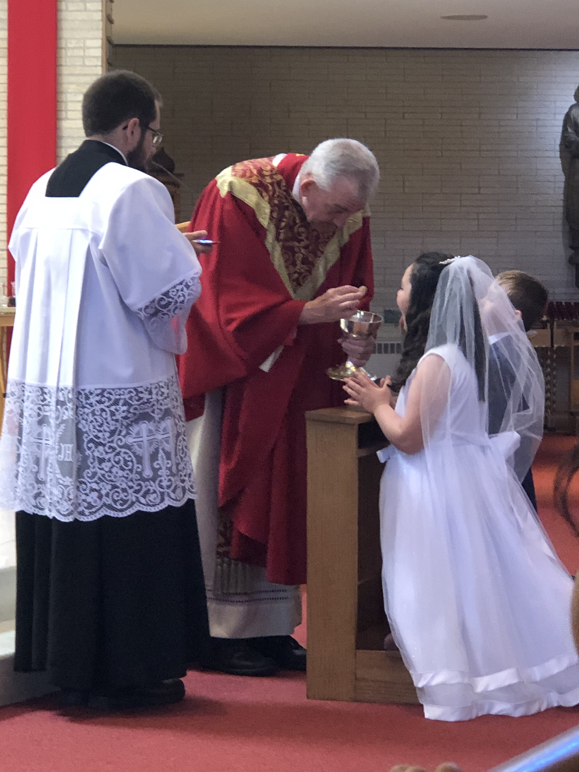
Approaches
Integration into traditional Catechesis Programs (this is the “ideal”)
Without any additional support
Mentor system (book)
With additional aid/catechist
parent/support person joining
Individual Instruction/Catechesis
Could still join for group activities, prayers, liturgies, etc.
At Home Catechesis with Parish Support – allowing parents as the primary educators of their children by providing them with the support and resources they need to do so.

Slide 14
When sitting down with support team
Ask about:
What has already been done in the home?
Learning styles
What has worked? What hasn’t?
Accommodation needs
Mobility, sensory, support
How can information, progress, and follow up best be communicated with the whole team?

Slide 15
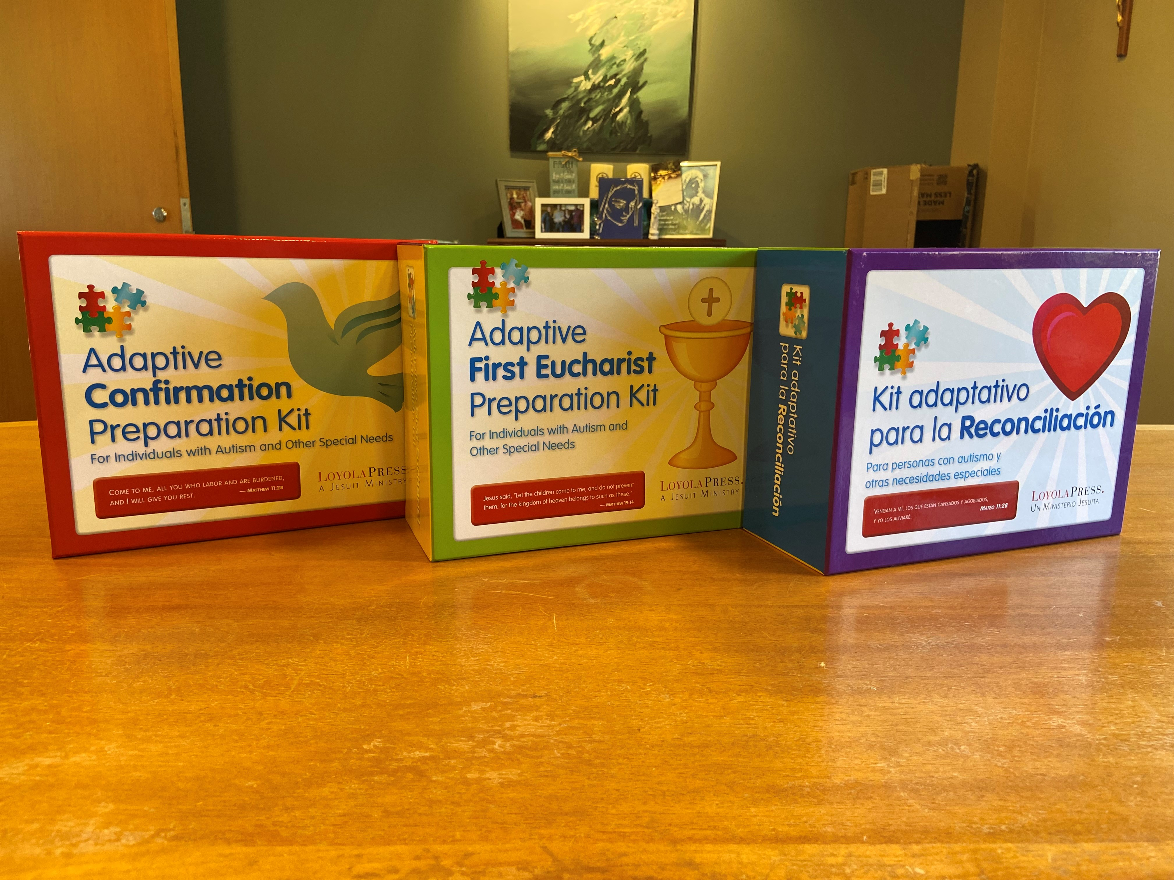
Resources and Materials
NcpD- National Catholic Partnership on Disability
https://ncpd.org/
Loyola Press
The Adaptive teacher
Sacramental kits

Slide 16
Resources and Materials
Catechesis of the Good Shepherd
Sensory rooms- ideal
Alternative - Traveling Sensory Kits

Slide 17
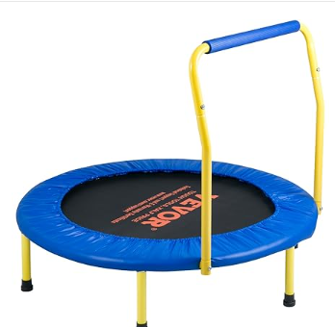
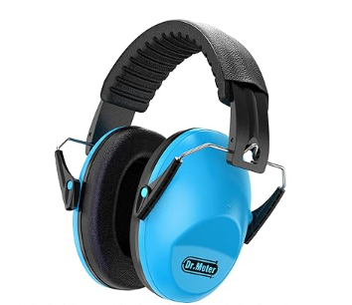
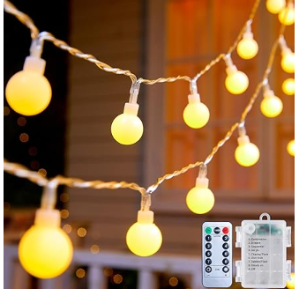
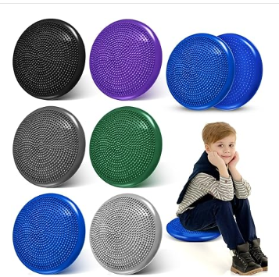
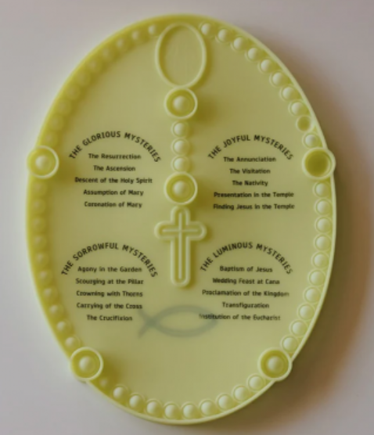
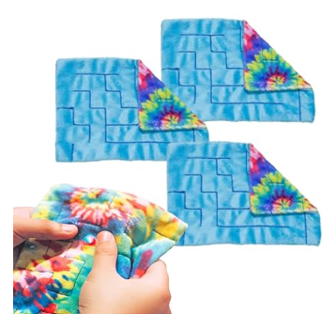
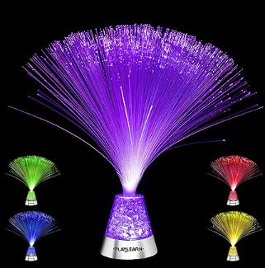
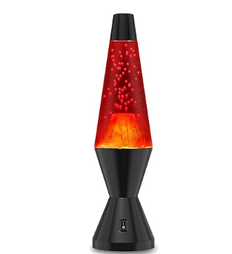

Slide 18
Barriers, Scenarios, and Questions
What barriers have you encountered in the inclusion and participation of people with disabilities in your ministry?
Open discussion of scenarios and strategies
Any other questions?

Slide 19
Thank you
Megan Wedwick
608-821-3051
Megan.Wedwick@MadisonDiocese.org
www.apdmadisondiocese.com

