Slide 1
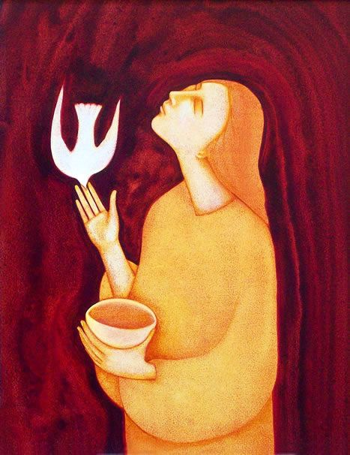
Filling
Your Cup

Slide 2
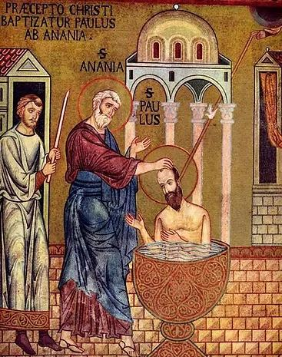
σκεῦος (skeuos)
Go, for this man is a chosen instrument of mine. . . .
Acts 9:15

Slide 3
Lesson #1:
Take care of your body
Ninety percent of what’s wrong with you
could be cured with a hot bath,
says God from the bowels of the subway.
but we want magic, to win
the lottery we never bought a ticket for.
(Tenderly, the monks chant, embrace
the suffering.) The voice of God does not pander,
offers no five year plan, no long-term
solution, nary an edict. It is small & fond & local.
Don’t look for your initials in the geese
honking overhead or to see thru the glass even
darkly. It says the most obvious crap—
put down that gun, you need a sandwich.
“The Voice of God”
Mary Karr

Slide 4
Vessel Reflection #1
Think about your physical body, your “vessel.” Reflect on your personal history, life situation, and needs.
What basic resources help you to “recover your strength,” like St. Paul?
How well have you been able to make use of those resources lately?
Recall the fact of your baptism, when the Lord claimed you for himself.
How does your baptism influence your “vessel”?
Describe in words or draw yourself as a baptized vessel: Who are you? More to the point, who are you to Christ Jesus? What does the Lord see when he looks at you in love?

Slide 5
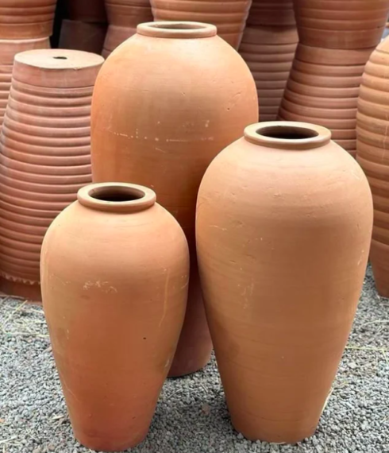
σκεύεσιν (skeuesin)
But we hold this treasure in earthen vessels, that the surpassing power may be of God and not from us.
2 Corinthians 4:7

Slide 6
What profit have workers from their toil?
I have seen the business that God has given to mortals to be busied about.
God has made everything appropriate to its time, but has put the timeless into their hearts so they cannot find out, from beginning to end, the work which God has done.
I recognized that there is nothing better than to rejoice and to do well during life.
Moreover, that all can eat and drink and enjoy the good of all their toil—this is a gift of God.
I recognized that whatever God does will endure forever; there is no adding to it, or taking from it. Thus has God done that he may be revered.
Lesson #2:
We are made for eternity—and therefore impossible to satisfy on earth
Ecclesiastes 3:9-15

Slide 7
Vessel Reflection #2
How has your earthen vessel been “afflicted in every way,” carrying in your body the dying of Jesus?
In general
Specifically in the service of Jesus and his Church
How has God shone light in your heart?
Name particular moments when God’s “surpassing power” surprised you.
What is it like to manifest the life of Jesus in your vessel?
“Whatever God does will endure forever”—how does that truth affect your heart?

Slide 8
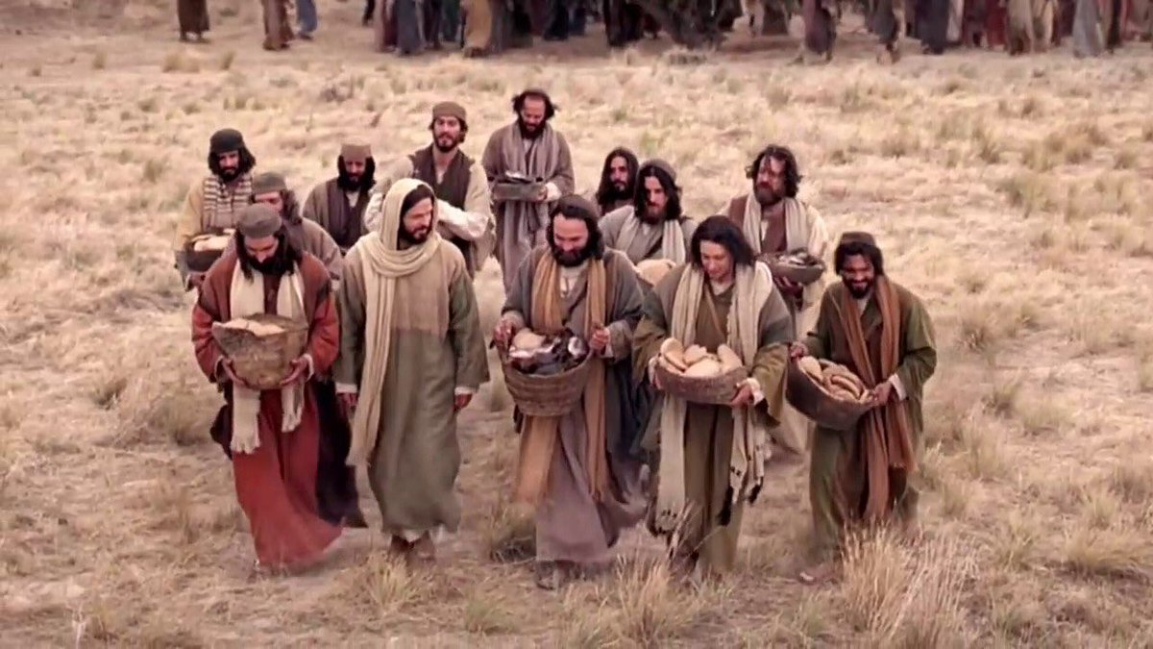
κοφίνους (kophinous)
So they collected them, and filled twelve wicker baskets with fragments from the five barley loaves that had been more than they could eat.
John 6:13

Slide 9
Lesson #3:
Let God surprise you
From wastes of rock He brings
Food for five thousand: on the thorns He shed
Grains from His drooping Head;
And would not have that legion of winged things
Bear Him to heaven on easeful wings.
From “New Readings”
Gerard Manley Hopkins

Slide 10
Filling Your Cup, in the service of the Lord
Take care of your body
Remember that we are made for eternity—and therefore impossible to satisfy on earth
Let God surprise you

Slide 11
My life is like a broken bowl,
A broken bowl that cannot hold
One drop of water for my soul
Or cordial in the searching cold;
Cast in the fire the perish'd thing;
Melt and remould it, till it be
A royal cup for Him, my King:
O Jesus, drink of me.
From “A Better Resurrection”
Christina Rossetti

